Slide 1
PIZZA STORE
MANAGEMENT SYSTEM
MySQL Database Project
Presented by: Dhana Lakshmi
Database design • SQL queries • Sales reporting

Slide 2
Project Overview
A relational database solution for day-to-day pizza store operations
Store records
Order processing
Business reports
Manage chefs, categories, pizzas, and customers.
Record customer orders and the items in each order.
Calculate sales, popular pizzas, and stock levels.
• Built with MySQL 8.0+ and relational tables
• Uses primary keys and foreign keys to connect data
• Includes 30 practice/reporting queries and a sales view
PIZZA STORE MANAGEMENT SYSTEM • 2

Slide 3
Objectives
What the project is designed to achieve
• Organize pizza, chef, category, customer, and order data
• Maintain accurate pizza prices and stock quantities
• Connect customers to orders and orders to pizza items
• Generate sales summaries and identify best-selling pizzas
• Practice SQL concepts used in database applications
PIZZA STORE MANAGEMENT SYSTEM • 3

Slide 4
Database Schema
Six core tables from the ER diagram, plus an optional payments table
CHEFS
CATEGORIES
PIZZAS
chef_id (PK), chef_name, experience
category_id (PK), category_name
pizza_id (PK), pizza_name, price, stock_quantity, chef_id (FK), category_id (FK)
CUSTOMERS
ORDERS
ORDER_DETAILS
customer_id (PK), name, email, phone
order_id (PK), order_date, customer_id (FK)
detail_id (PK), order_id (FK), pizza_id (FK), quantity_ordered, price_at_time_of_order
PAYMENTS (optional)
payment_id (PK), order_id (FK), payment_date, amount, payment_method, payment_status
PIZZA STORE MANAGEMENT SYSTEM • 4

Slide 5
ER Relationships
One-to-many relationships connect the database tables
• CHEFS 1 → N PIZZAS
• CATEGORIES 1 → N PIZZAS
• CUSTOMERS 1 → N ORDERS
• ORDERS 1 → N ORDER_DETAILS
• PIZZAS 1 → N ORDER_DETAILS
• ORDERS 1 → 1 PAYMENTS (when order_id is UNIQUE)
PIZZA STORE MANAGEMENT SYSTEM • 5

Slide 6
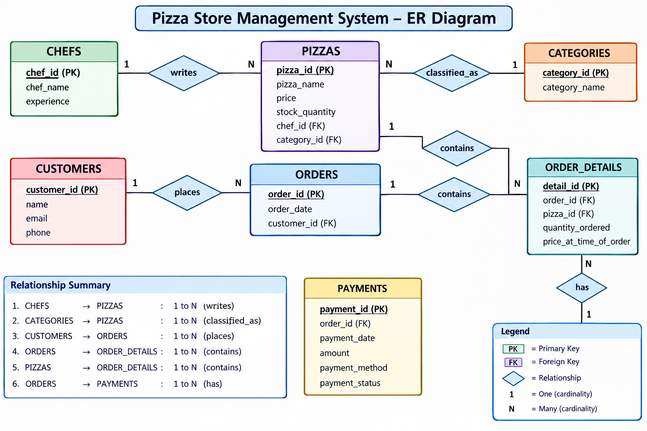
Entity Relationship Diagram
Conceptual view of entities, keys, and relationships
PIZZA STORE MANAGEMENT SYSTEM • 6

Slide 7
SQL Concepts Used
Core SQL features demonstrated in the 30 queries
SELECT / WHERE
JOIN / LEFT JOIN
GROUP BY / HAVING
Retrieve and filter records
Combine related tables
Summarize and filter groups
ORDER BY / LIMIT
Aggregates / Subqueries
UPDATE / VIEW
Sort results and restrict rows
COUNT, SUM, AVG, MIN, MAX
Modify data and save a reporting query
PIZZA STORE MANAGEMENT SYSTEM • 7

Slide 8
Example SQL Queries
Examples from the project
Filter by price
Calculate total sales
SELECT pizza_name, price
FROM pizzas
WHERE price > 250;
SELECT SUM(quantity_ordered * price_at_time_of_order)
AS total_sales
FROM order_details;
Count pizzas by category
Sort by price
SELECT category_id, COUNT(*)
FROM pizzas
GROUP BY category_id;
SELECT pizza_name, price
FROM pizzas
ORDER BY price ASC;
PIZZA STORE MANAGEMENT SYSTEM • 8

Slide 9
Sales Reporting View
A reusable virtual table for order-level item reporting
• View name: pizza_sales_report
• Shows order ID and date, customer name, pizza name, quantity, unit price, and line total
• Line total = quantity_ordered × price_at_time_of_order
• Run SELECT * FROM pizza_sales_report; to view the report
• Use the report to review sales records and compare pizza demand
PIZZA STORE MANAGEMENT SYSTEM • 9

Slide 10
Store Operations
How the database supports a typical order
1. Customer
Customer details are stored in CUSTOMERS.
2. Order
A new record is created in ORDERS.
3. Items
Each pizza and quantity is stored in ORDER_DETAILS.
4. Stock
Stock can be reduced when an order is accepted.
5. Reporting
SQL queries calculate order totals and sales.
PIZZA STORE MANAGEMENT SYSTEM • 10

Slide 11
Benefits and Future Enhancements
Current capabilities and possible improvements
Benefits
Future enhancements
• Structured, related data
• Faster searching and reporting
• Stock visibility
• Reusable sales view
• SQL learning and practice
• Add payments and refunds
• Add order status and delivery details
• Add constraints and indexes
• Build a Python front end
• Create a Power BI sales dashboard
PIZZA STORE MANAGEMENT SYSTEM • 11

Slide 12
CONCLUSION
The Pizza Store Management System demonstrates how MySQL can organize store data, connect orders with customers and pizzas, track stock, and produce sales reports.
Thank You
Questions?

